Slide 1

Suprise Housing Price Prediction
mr. Hritik yadav
fliprobo-internship 34

Slide 2

Introduction to Housing price prediction

Slide 3
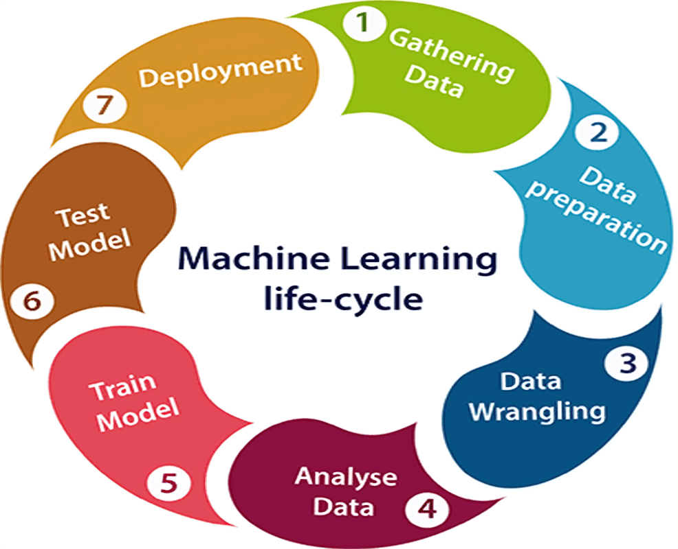
Project Flow Chart

Slide 4
Project Flow Tasks Perform
Data Integrity Check For presence of duplicate or any data error.
Missing values present in data set. Features containing more than 40% missing value are drop from investigation.
Imputation of missing value with mean, median or mode is performed.
Feature Engineering for extraction of few new features out of existing features.
Feature selection
Label Encoding of Categorical features
Splitting of dataset into input & target feature
Standard Scaling of data

Slide 5
Problem Statement
A US-based housing company named Surprise Housing has decided to enter the Australian market. The company uses data analytics to purchase houses at a price below their actual values and flip them at a higher price. For the same purpose, the company has collected a data set from the sale of houses in Australia.
It is required to build a model using Machine Learning in order to predict the actual value of the prospective properties and decide whether to invest in them or not.
For this company wants to know:
Which variables are important to predict the price of variable?
How do these variables describe the price of the house?
How to construct a realistic model to precisely predict the price of real estate has been a challenging topic with great potential for further research.
Our main objective of doing this project is to build a model to predict the house prices with the help of other supporting features.

Slide 6
Conceptual Background
There are many factors that have an impact on house prices, such as the number of bedrooms and bathrooms. House price depends upon its location as well. A house with great accessibility to highways, schools, malls, employment opportunities, would have a greater price as compared to a house with no such accessibility.
The No Free Lunch Theorem state that algorithms perform differently when they are used under the same circumstances.
The study answers the following research questions:
- Research question 1: Which machine learning algorithm performs better and has the most accurate result in house price prediction? And why?
- Research question 2: What are the factors that have affected house prices in Australia over the years?

Slide 7
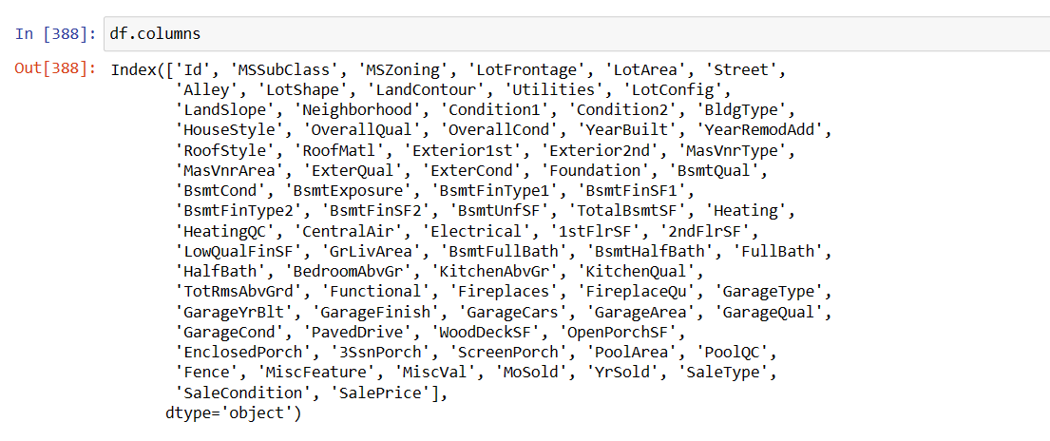
Data Sources and their formats
Data set provided by Flip Robo was in the format of CSV (Comma Separated Values). There are 2 data sets that are given. One is training data and one is testing data.
1) Train file will be used for training the model, i.e., the model will learn from this file. The dimension of data is 1168 rows and 81 columns.
2) Test file contains all the independent variables, but not the target variable. The dimension of data is 292 rows and 80 columns.

Slide 8
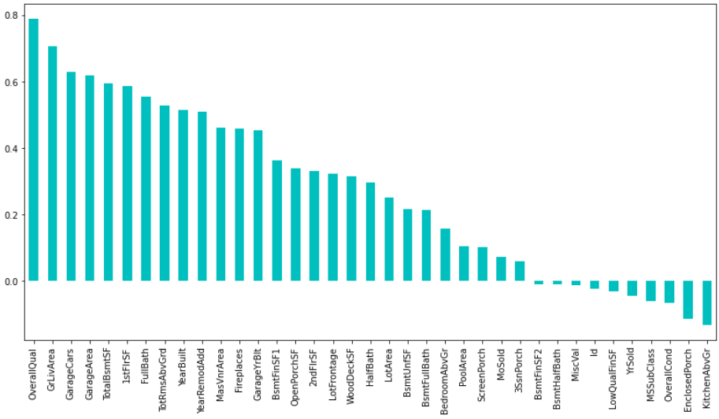
Correlation Heatmap

Slide 9
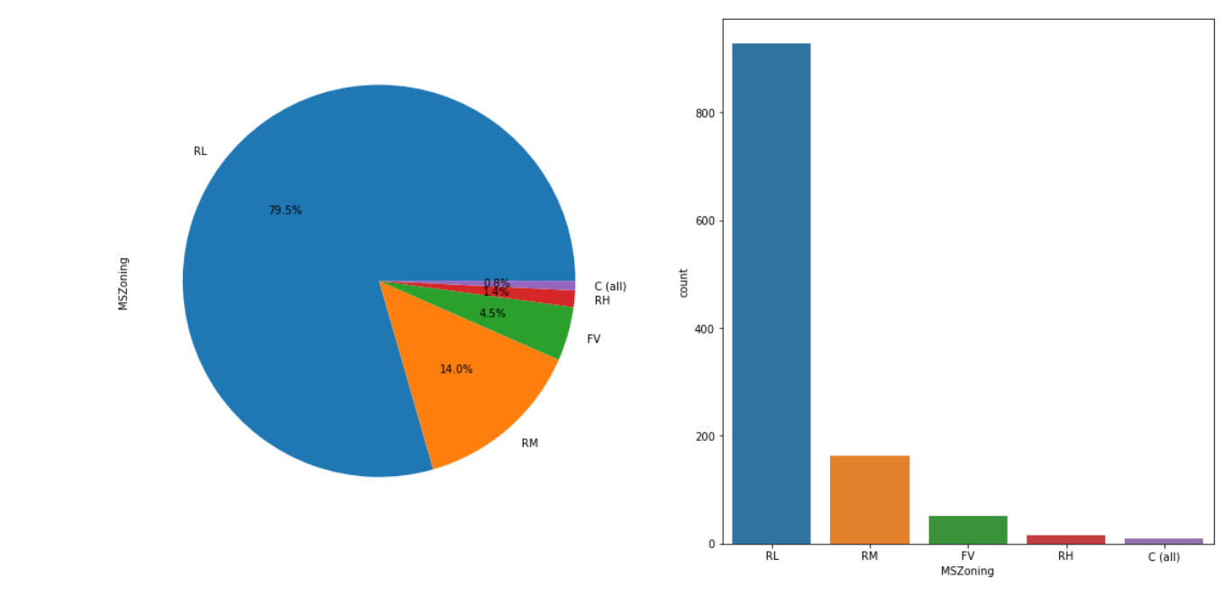
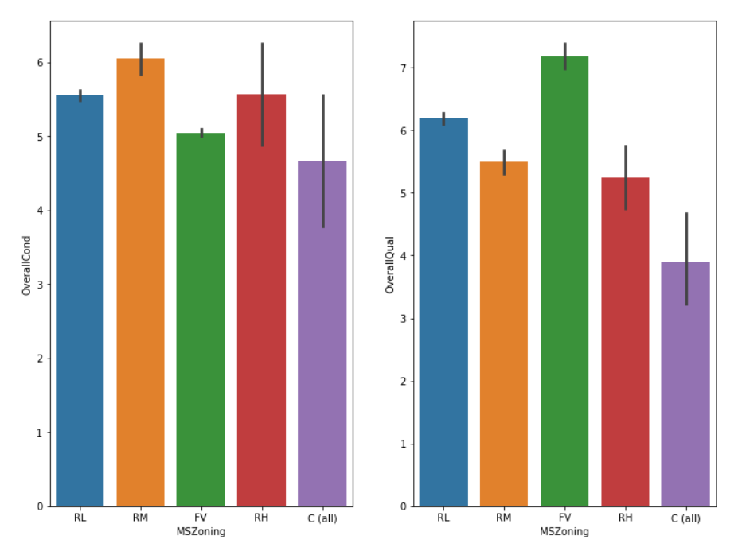
Exploratory Data Analysis
63% REGULAR SHAPE TAKE PLACE
BUT SALE OF MODERATELY IRREGULAR IS HIGHEST THEN FOLLOWED BY SLIGHTLY IRREGULAR
the overall material and finish of the houses(overall qual) is better in Floating Village Residential
the overall condition of the house is better in Residential Medium Density

Slide 10
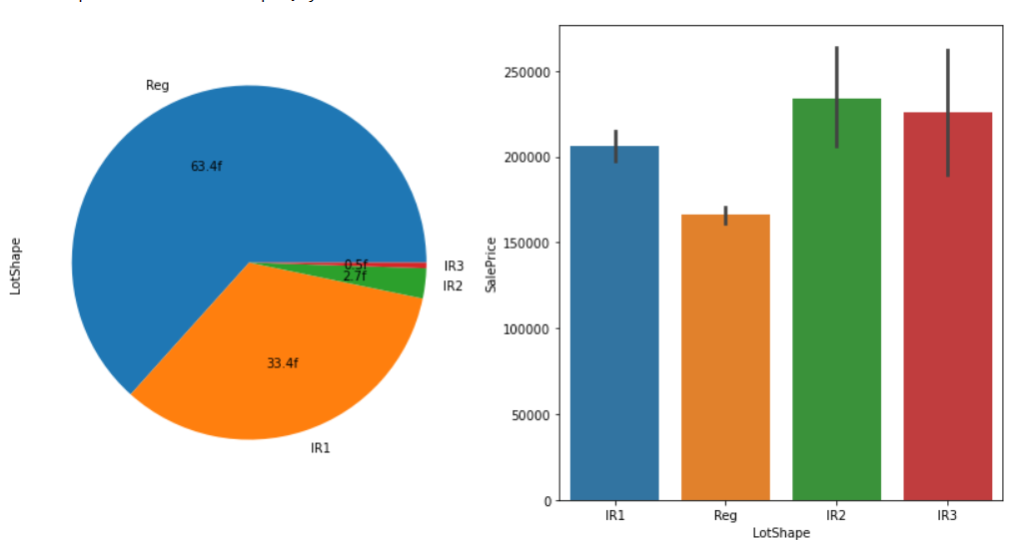
63% REGULAR SHAPE TAKE PLACE
33.33% share take by IR1
the sale price of IR2 and IR3 is almost equal
then IR1 takes place s sale price
Reg is least sale price

Slide 11
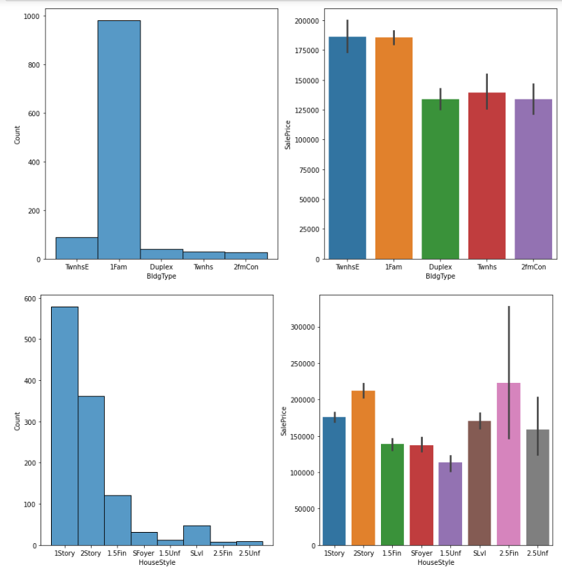
#observation:-
*IN Type of dwelling. Single-family Detached HAS HIGHEST COUNT
*IN Style of dwelling. One story HAS HIGHEST COUNT FOLLOWED BY Two story
#SALE OBSRVATION:-
*IN Type of dwelling.Townhouse End Unit AND Single-family Detached HAS HIGHEST SALE PRICE
*IN Style of dwelling.Two and one-half story: 2nd level finished HAS HIGNEST SALE PRICE

Slide 12
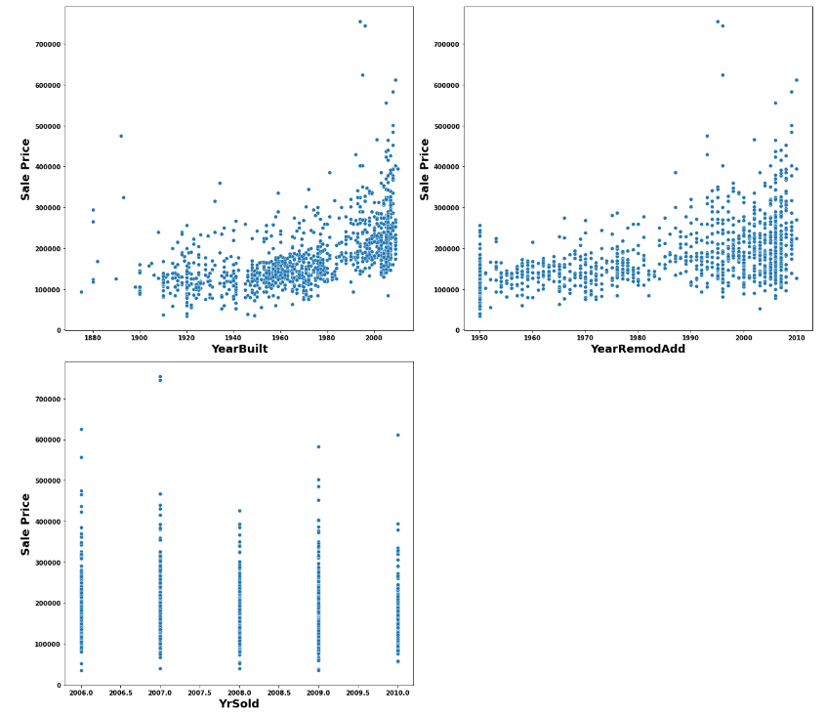
OBSERVATION:-
We can see that as Property get older with time its sale Price get depricates.
20 years after Remodelling Price of properties start decreases.
Older the garage age less the price of Property.

Slide 13
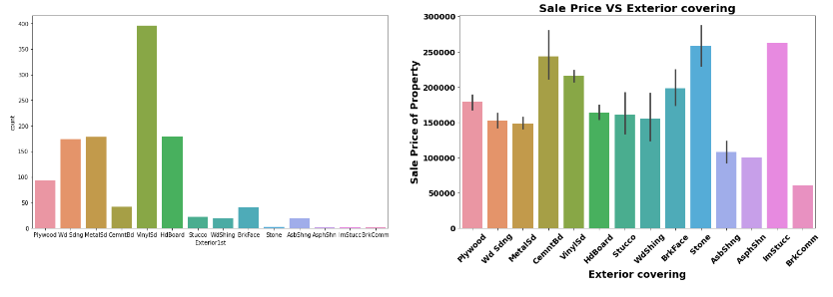
as we observed in the figure Vinyl Siding is used highest in the property
the Stone,Cement Board,Imitation Stucco has the highest sale price

Slide 14
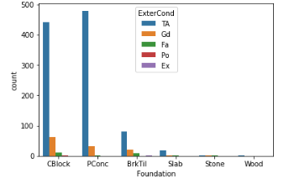
poured contrete has the good condition followed by cinder block

Slide 15
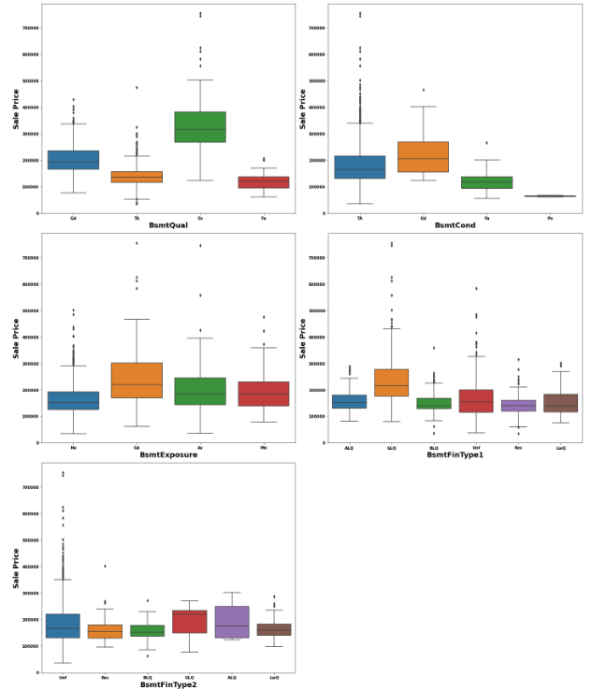

Slide 16
Machine Learning Model Building
The different regression algorithm used in this project to build ML model are as below:
Linear Regression
Random Forest Regressor
Decision Tree Regressor
Ridge Regression
XGB Regressor
Extra Tree Regressor

Slide 17
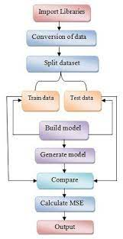
ML Model Building Flow
Standard Scaling of Data
Splitting Training Data Using test_train_split
Finding Best Random state
Training ML Model on Different Algorithms
5 Fold Cross Validation of Different Model
Selection of Best Model Based on Evaluation Criteria
Hyper Parameter Tuning of Best Model
Saving final Model Using Joblib
Predicating Test Dataset using Final Model

Slide 18
Key Findings and Conclusions of the Study
Algorithm R2 Score CVScore RandomForest Regressor 90.27 83.12%
XGB Regressor 86.67 82.05% Linear Regression 82.41 76.59% Decision Tree Regressor 50.27 67.25% Extra Tree Regressor 89.65 83.36% Ridge Regression 87.37 78.82% Random Forest Regressor Hyper Parameter Tuned Final Model
90.06 84.56%
➢ Random Forest Regressor giving us maximum R2 Score, so Random Forest Regressor is selected as best model.
➢ After hyper parameter tuning Final Model is giving us R2 Score of 90.27% which is slightly decread compare to earlier R2 score of 90.06%.

